Slide 1

G2M Case Study
G2M insight for a Cab Investment firm
- Nuri Tas
20-August-2022

Slide 2
Background –G2M(cab industry) case study
After a sharp increase in the Cab Industry in the recent years and a flow of large players to the industry, XYZ, a private equity firm in the US, is planning to do a large investment in Cab industry in US.
Goal: Guide XYZ with data-driven stories to discover the right firm they should invest in.
The analysis has been divided into four parts:
Data Understanding
Forecasting profit and number of rides for each cab type
Finding the most profitable Cab company
Recommendations for investment

Slide 3

Data Exploration
We have 15 features (1 additional feature from
weather_df )
The time range of the master data is:
2016-01-31 to 2018-12-31
There are 359,392 rows in master dataframe
The assumptions:
The profit column in master dataframe is calculated by taking the difference
Between Price_Charged and Cost_of_Trip
Transaction ID dataset contains more Transaction IDs than cab data,
so the extra ID’s are cut from Transaction ID
Cab_Data.csv
Customer_ID.csv
Transaction_ID.csv
City.csv
weather_df.csv
masterdata

Slide 4
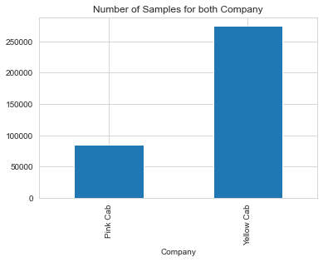
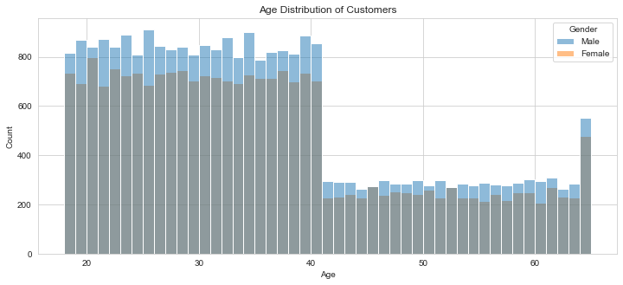
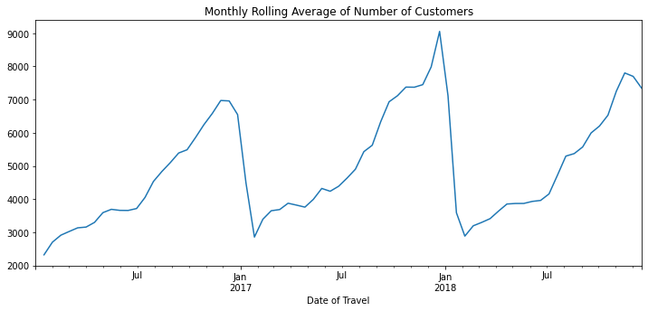
Profit Analysis
Overview of Data

Slide 5
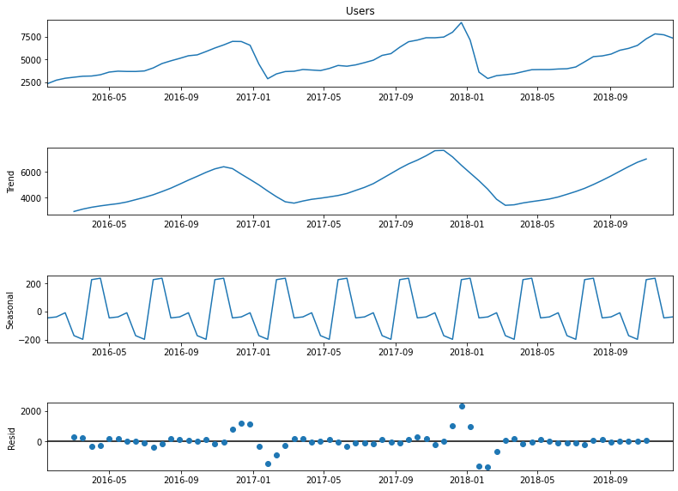
Season and Trend Analysis in Customer Numbers

Slide 6
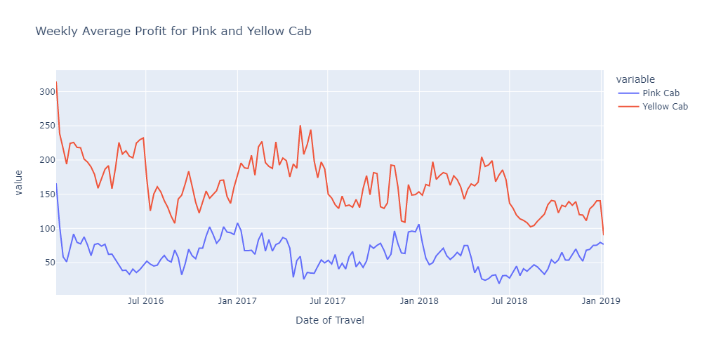
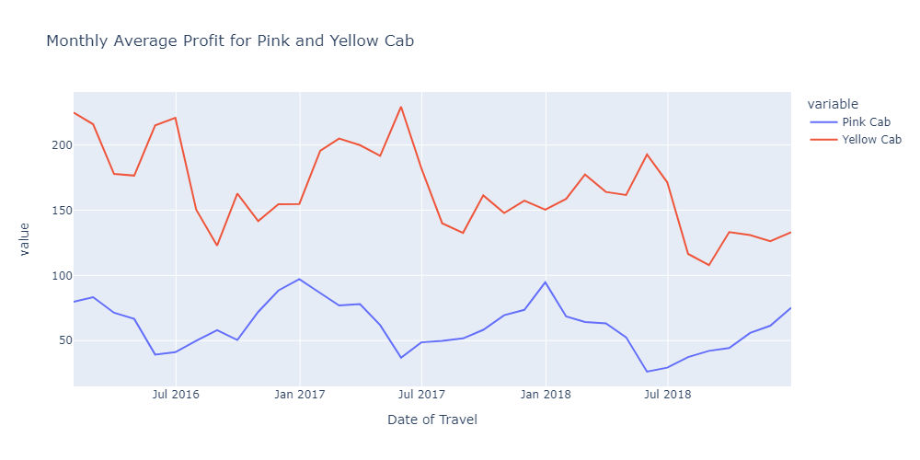
Weekly and Monthly Average Profit

Slide 7
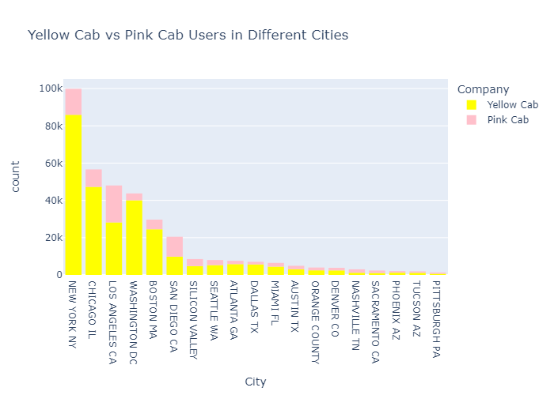
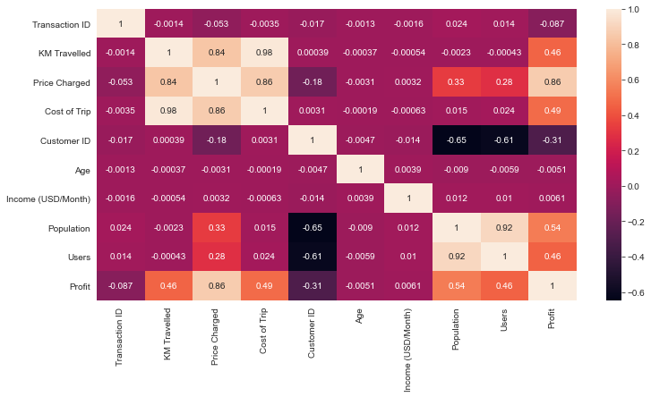
Companys’ Performance in each City
Heatmap shows us that city population is one of
most positively correlated factor with profit, and
the graph on the left hand side shows city vs
company ordered with respect to cities’ populations

Slide 8
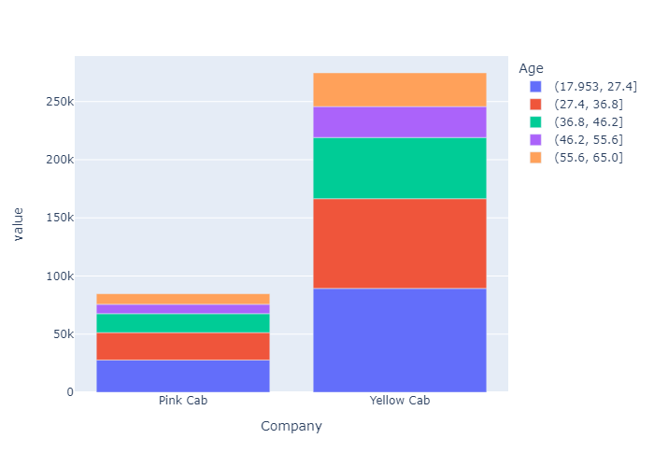
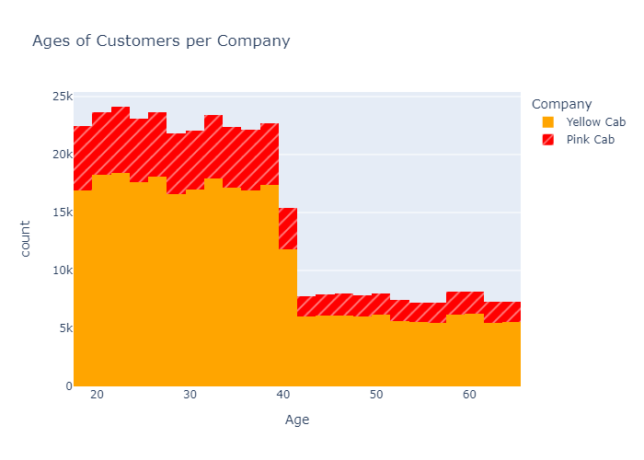
Popularity of Companies across all Ages
Yellow Cab attracted more customers than Pink Cab in all age groups, and also in 5 age segments.

Slide 9
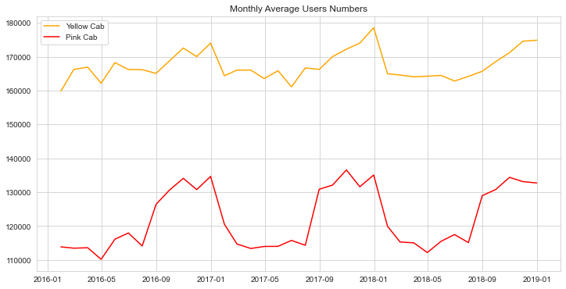
Monthly Average User Numbers
Customers always prefered more Yellow Cab over Pink cab for the whole time range
Additionally, Yellow Cab experienced less fluctuations while Pink Cab went through sharp up and downs
Yellow Cab’s monthly average user numbers never felt under 160,000 while Pink Cab never saw the number 140,000

Slide 10
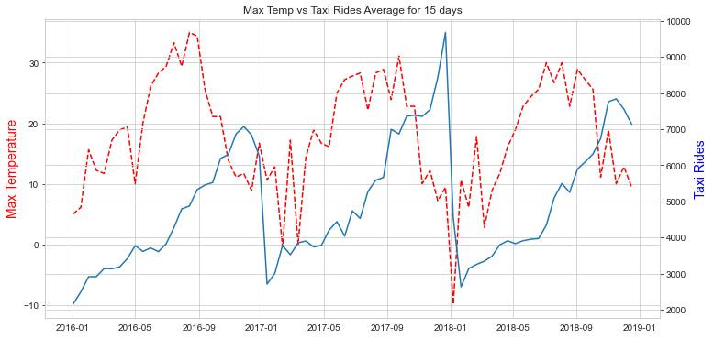
Weather vs Taxi Rides
Daily max temperature
has a clear correlation with the number of taxi rides
As the max temperature goes higher, the number of rides follows a similar trend

Slide 11
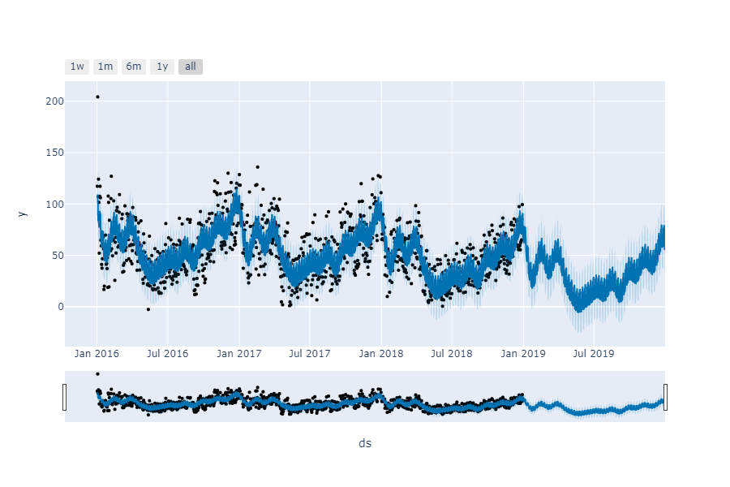
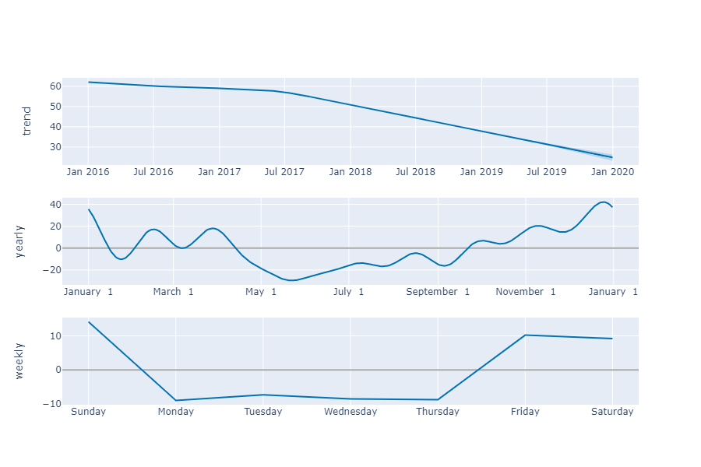
Daily Profit Forecasting for Pink Cab
The daily profit of Pink Cab is forecasted to reach around 80 USD after a few months of downward period
A steady downward trend is expected in daily profits

Slide 12
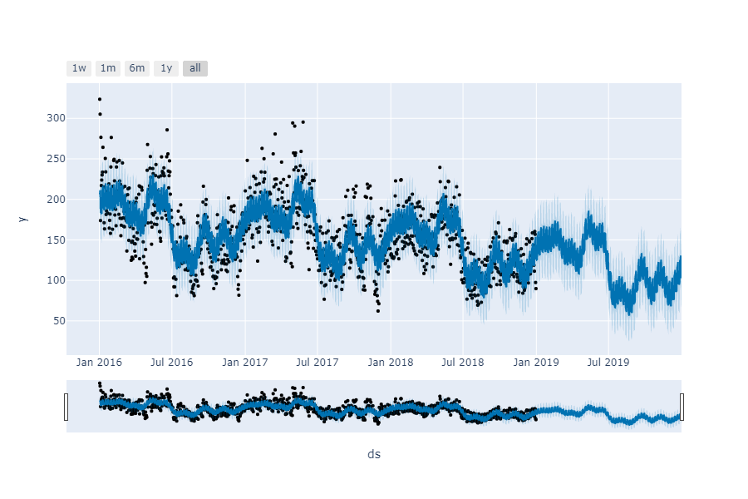
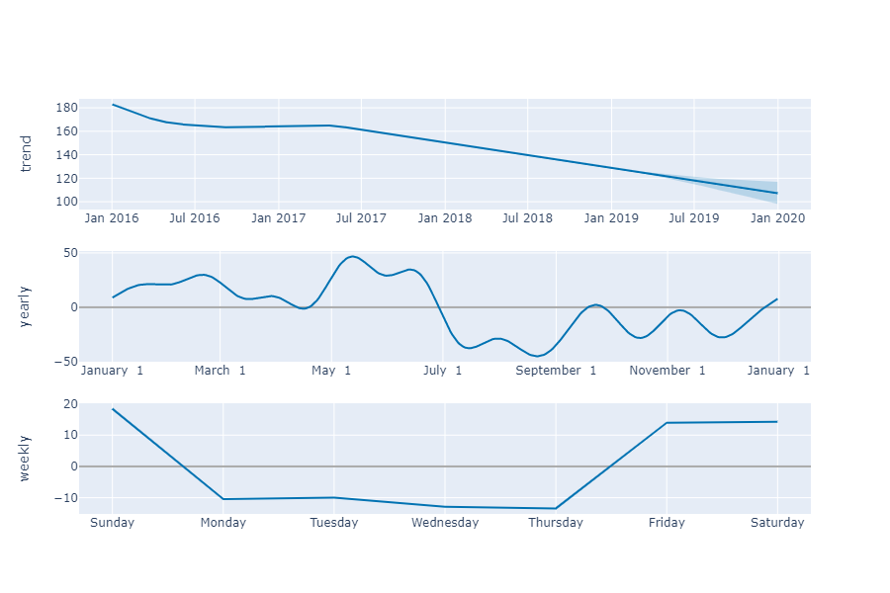
Daily Profit Forecasting for Yellow Cab
The daily profit of Yellow
Cab is expected to reach
Around 150 USD by the end
of 2019
Similar to Pink Cab, a
general downward trend is
anticipated in daily profits

Slide 13
Recommendations
We finally arrived the following conclusion:
Customer Flow: Yellow cab has higher customers than Pink Cab in almost all cities, and all 5 most populous cities.
Monthly Average Profit: Yellow Cab has higher monthly average profit thank Pink Cab for the vast majority of time and it is more persistent agains pushback and has less fluctuations compared to Pink Cab.
Popularity Among Ages : Yellow cab more popular than Pink Cab in all distinct ages from 18 to 60, and we even found that it is still popular among 60+ groups as much as in 18-25 age group.
User Numbers: Yellow cab had always reached more customers and never felt under 160,000 in the customer numbers while Pink Cab has never reached the number 140,000
Forecasting: Daily forecasting results showed that the daily profit of Yellow Cab will be almost two times of Pink Cab despite the fact that both companies are expected to go under a downward period in profits.
Based on all the points we made above , we will recommend XYZ to invest in Yellow cab.

Slide 14
Thank You

